Slide 1
JDBC, Servlet, JSP

Slide 2
Types of applications using java
5. Interoperable application:
Ex. If Redbus (java) is taking services from goibibo (.net) then they need to exchange data using xml or json format
J2SE (Standard edition)
Core java (1,2)
J2EE (Enterprise edition) Advanced java (3,4,5)
GUI (Graphical user interface)
Calculator
CUI (Character user interface) executed from command prompt
3. Web application: Deploy on the server and can be accessed from anywhere using a browser. Eg. Facebook
Technologies used: servlet, struts, jsp etc.
s.o.p(“Hello world”)
Standalone applications/Desktop based app (running on single machine)
Ex. Calculator, media player, antivirus
Technologies used: swing, AWT, JavaFX
4. Enterprise/Distributed application. Ex. ICICI, IRCTC
Boon train tickets using IRCTC
From RedBus if we try to book a ticket. Both IRCTC and RedBus server require interoperability. Through EJB (Enterprise Javabeans) components we can make such applications if both are using java application.

Slide 3
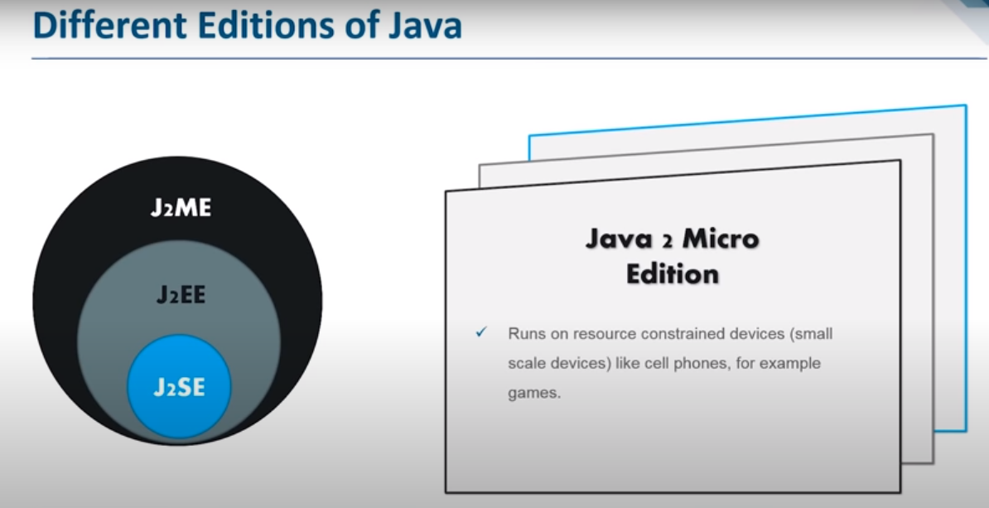

Slide 4
RF
SERVER
CLIENT
DATABASE
H
B
Server side technologies used to write programming at server side. Ex:
Servlet, JSP, struts, spring, .net, PHP etc.
Client side technologies used to write programming at client side. Ex:
HTML, JSP, HTML5, CSS3, Java Script
JDBC, Hibernate framework
Database- used to store the data
Ex. Oracle, MySQL
HTTP/HTTPS
H
B
RF
Client sending request to sever
client prepares RF (Request Format) and sent it to http/https
It contains header and body field. Header contains browser info and body contains actual request details
Http carry the RF to the server side.
Ex. All browsers
Server checks request body and process the
request. Finally the response will be generated.
2. Http prepares RF (Response Format) contains h and b
3. Body contains actual response and head contains browser info
4. Server: Tomcat (Apache), glassfish (Sun/Oracle), Jboss (Jboss community), Weblogic (Oracle), Websphere (IBM) etc.
Note- Servlet is server side technology executed by server or it is an object executed at server side.
Notes:
JDK is required to run the java application (core java)
Advanced java application - No files to install, Predefined support is maintained in form of jar files.
Servlet: Servelt-api.Jar (a group of .class files in form of class type, interface type or enum type)
Servlet specifications (interface: rules and regulations) are given by SUN microsystem, the implementations for which are given by server vendors in the form of jar files.
Ex. Tomcat Server provided implementations for the specifications provided by SUN microsystem.
Core java- JVM, Oracle- DB engine, JDBC- JVM, Servlet, JSP- Server

Slide 5
Servlet Specification provided by SUN microsystem
Servlet-api.jar
…
Jee.jar
weblogic.jar
Tomcat Server
Glassfish Server
WebLogic Server
…
Server Vendors
Advantage: Initially we Developed the application using Tomcat server and after some time the server has to be changed,
no need to touch the specifications, change the build path configuration (jar file).

Slide 6
Imp points regarding Installation
Tomcat installation default takes 8080 port number
Oracle software default port number is 8080
Having same port will lead to crash, assign 9999 port number to Tomcat.
Provide username and password
JRE must be installed before Tomcat as it requires JRE libraries.
Once installed>> check the default path>>C:\Program Files\Apache Software Foundation\Tomcat 8.5

Slide 7
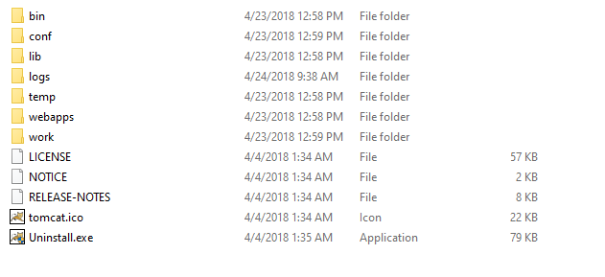
Configuration details: username, password in tomcat-users.xml file, server.xml file contains port number
Binary executables used to start and stop the server
Group of Jar files are present here
When the Server started and installed? Report generated
Contains temporary files
Converted servlets are present here. JSP internally converted into servlets before execution
Contains group of projects. Main folder for the application, used to deploy the project on the server (to place the project on the server)
Placing the project into this folder

Slide 8
How to start the server??
start the server form bin file
Connect to the server using http://localhost:8080 (enter your server port number) on your machine
Click on Manager App file
Provide the username and password
Deployed applications are available here.

Slide 9
Building your first Web Application>> Basics
Prepare web application directory structure
Prepare form page e.g.. Registration.html, login.html files
Prepare the servlet e.g. LoginServlet.java
DD file is prepared, deploy the project into Server (Place the project into webapps folder)
Registration
RegistrationServlet.java
login
LoginServlet.java
Update
UpdateServlet.java
Web.xml file (Deployment Descriptor file) is required to provide the mapping between HTML file Servlet. It provides configuration details about the mapping

Slide 10
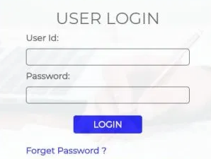
CLIENT
Login Page
SERVER
Request sent
Request process
Response received

Slide 11
Building your first Web Application>> Steps
Prepare the directory structure: web app contains a group of resources, we cannot place all the resources in a single folder hence create multiple folders
Prepare form pages (Login.html, Registration.html)
Prepare the servlet (LoginServlet.java)
Prepare DD file or Web.xml for providing the mapping between HTML file and servlet.
Deploy the project into server (place inside Webapps folder)
Start the server and access the application
app
HTML
JSP
JS
Images
themes
WEB-INF
Web.xml
Jar files
classes
Step 1
Prepare the directory structure
.class files
Lib folder
Public area
Private area

Slide 12
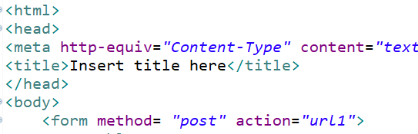
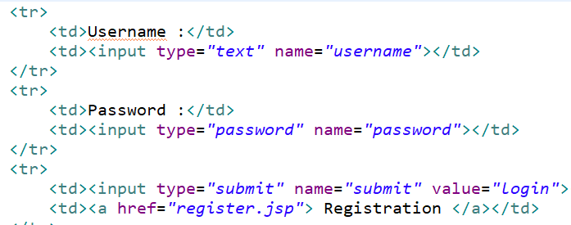
Step 2
Prepare form page
Sample Example>>
Logical names

Slide 13
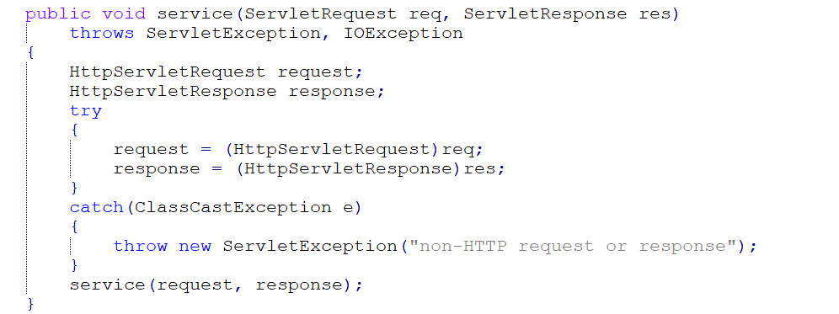
There are two service methods present in HttpServlet.java file (use DJ decompiler to see the .java file from HttpServlet.class file) present in servlet-api.jar file. The server by defaults calls the given below version of service method
Converting normal request type to HttpServlet request type ..)
calling protected service method

Slide 14
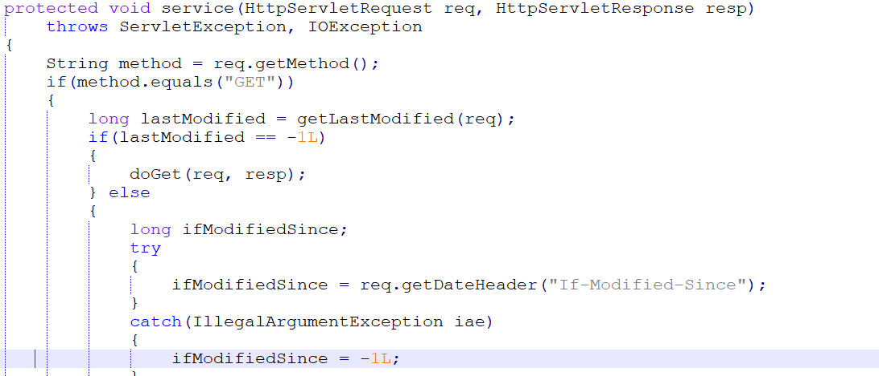
client details are getting stored in req object
Data we want to display in browser window is stored in resp object
Identify the service type (“get” or “post” method) and forward the request to the specific method

Slide 15
Servlet creation>> 3 approaches
Interface Servlet
{
init();
service();
destroy();
getServletInfo();
getServletConfig();
}
class MyServlet implements Servlet
{
@Override 5 methods
}
lifecycle methods
Automatically called by the server
class MyServlet extends GenericServlet
{
@Override 1 method (service)
}
abstract class GenericServlet
{
init() {}
abstract service() ;
destroy() {}
getServletInfo() {}
getServletConfig() {}
}
Its is protocol independent: For any type of request, FTP, SMTP, HTTP etc. same service method will be executed
Notes:
Servlet-api.jar>>
C:\Program Files\Apache Software Foundation\Tomcat 8.5\lib
DJ java compiler

Slide 16
class MyServlet extends HTTPServlet
{
}
abstract class HTTPServlet extends GenericServlet
{
All implementations are complete
}
HTTPServlet is abstract but it does not contain any abstract methods.
We do not want to call the methods by creating the object of HTTPServlet class hence it is made abstract
Its is protocol dependent: able to handle only HTTP type request. doGet() doPost() doDelete() doTrace() etc.
HTTP stands for hypertext transfer protocol. It's a protocol that allows communication between different systems. Most commonly, it is used for transferring data from a web server to a browser to view web pages

Slide 17
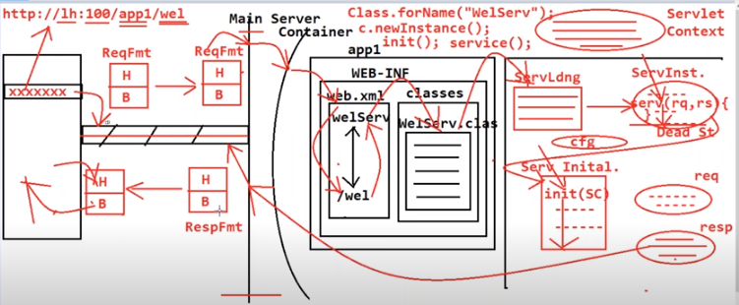
Servlet lifecycle-

Slide 18
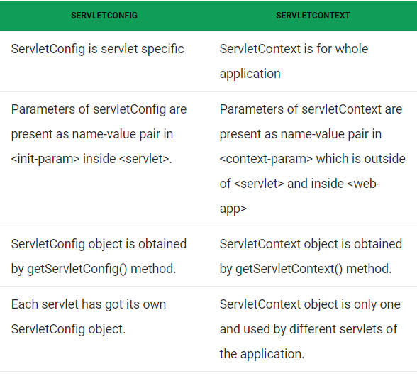
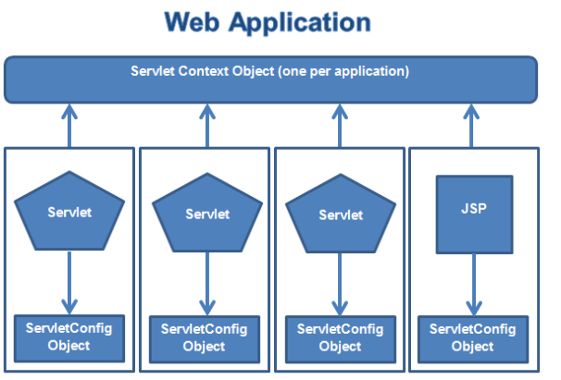
Difference between ServletConfig and ServletContext in Java Servlet?
Example is given in the Notes section below
Notes:
ServletConfig: Suppose I would like to know the amount payable for the number of mangoes purchased. I read the number of mangoes from the client html file. Then, which is the better place to have the cost of mango placed? Moreover, the cost of mango changes everyday. May be database table. If it is placed in a database table, for reading it is required a JDBC program with an extra overhead of database connection. The best place is web.xml file which does not require compilation every time the mango cost changes. Here, the servlet can be initialized with mango cost by the time client sends the number of mangoes. But remember, this mango cost is readable by one servlet only because the mango cost is placed within the <servlet> tag.
ServletContext: I take the same above scenario with different perspective. Imagine there are multiple fruit vendors (each fruit shop is represented by one Servlet) and all require the cost of one mango. That is, the mango cost should be global. The place to put the cost of mango is in which exists outside any <servlet> tag. As it is outside any <servlet> tag, every servlet under execution can access.

Slide 19
Servlet life cycle -- Imp
Loading Servlet Class : A Servlet class is loaded when first request for the servlet is received by the Web Container.
Servlet instance creation :After the Servlet class is loaded, Web Container creates the instance of it. Servlet instance is created only once in the life cycle.
Call to the init() method : init() method is called by the Web Container on servlet instance to initialize the servlet.
Signature of init() method :
4. Call to the service() method : The containers call the service() method each time the request for servlet is received. The service() method will then call the doGet() or doPost() methos based on the type of the HTTP request.
Signature of service() method :
5. Call to destroy() method: The Web Container call the destroy() method before removing servlet instance, giving it a chance for cleanup activity.

Slide 20
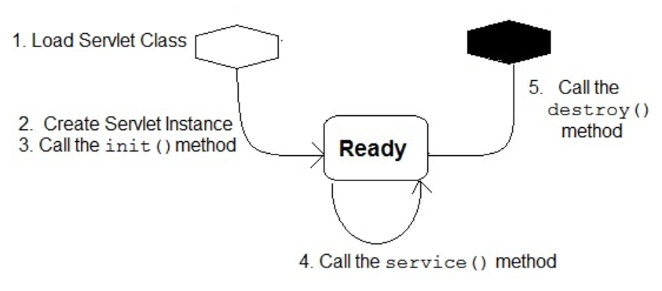
No. of web applications = That many number of ServletContext objects [ 1 per web application ] No. of servlet classes = That many number of ServletConfig objects

Slide 21
Note: Container
The container, sometimes referred to as a servlet engine, is provided by a Web or an application server within which servlets run. Similar to simple Java programming, servlets are Java classes compiled to bytecode. These bytecodes are loaded dynamically into a Java technology-enabled Web server.
The servlet classes generally interact with the server via an HTTP request/response mechanism implemented by the servlet engine. The primary function of the container is to contain servlet classes and manage their life cycle. Apart from supporting HTTP protocol, the servlet container also supports request/response based protocols, such as HTTPS, for a more secure network interaction.
ServletConfig object is created just before calling the init() method of servlet lifecyle.
Server contains a number of applications, server identifies every application when we start the server and creates one object for every application named as ServletContext object.
App1---- sc1 For every servlet, life cycle methods will be executed
App2-----sc2
App3-----sc3
ServletConfig object is specific to a particular servlet, it contains configuration details of the servlet
ServletContext object is specific to web application, it contains context details of the webapplication (getServletContext() method)

Slide 22
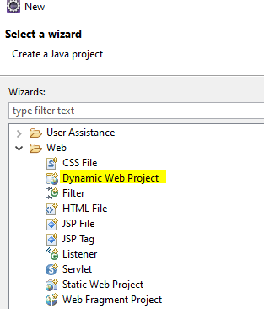
Creating First web application Step-1 open eclipse and create a new dynamic web project (go to other option (web) if not visible directly

Slide 23
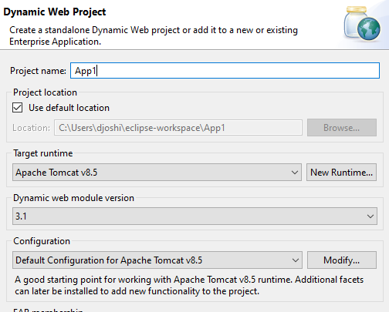
Step-2
Give a name to the project and
Provide the info as shown in the
screenshots
Annotations are supported from 3.0 version onwards

Slide 24
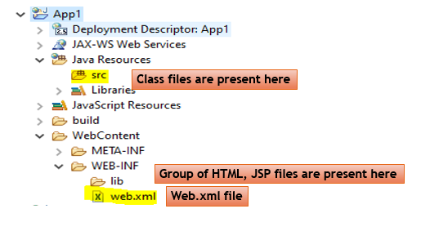
Directory structure generated by Eclipse

Slide 25
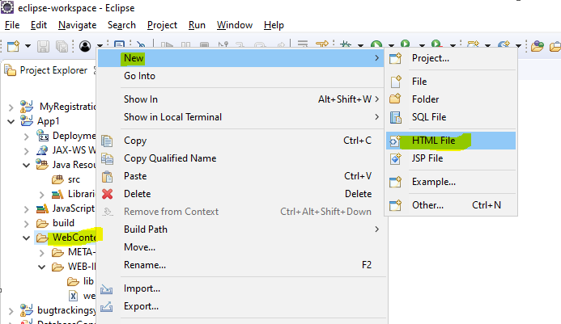
Step 3: Create html file

Slide 26
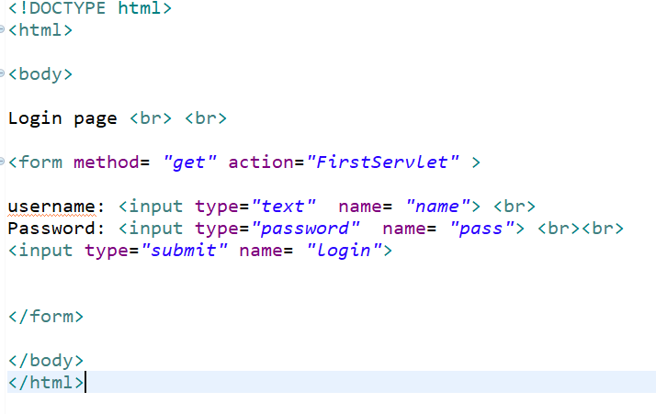
An example of login.html file
Servlet url
Difference between get and post method??
Logical names

Slide 27
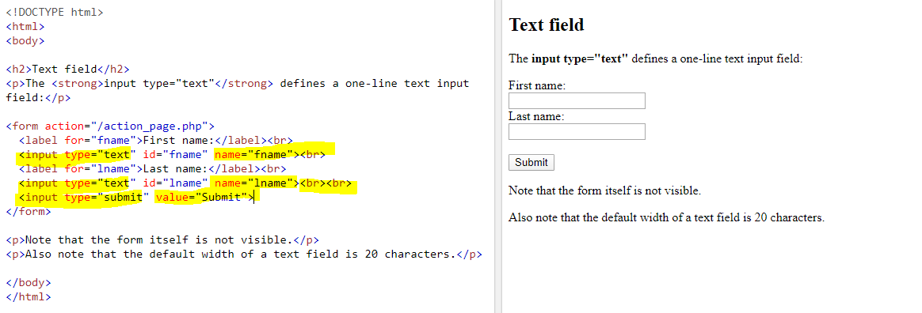
Example of HTML sample code (to understand the HTML tags

Slide 28
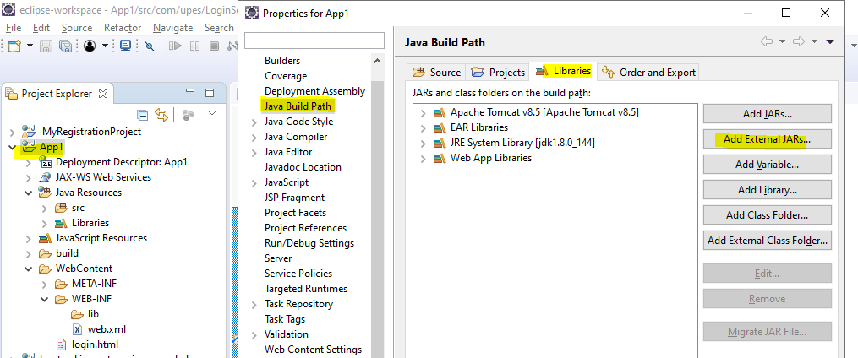
Step 4- Build path configuration: Add servlet-api.jar file before creating the Servlet class

Slide 29
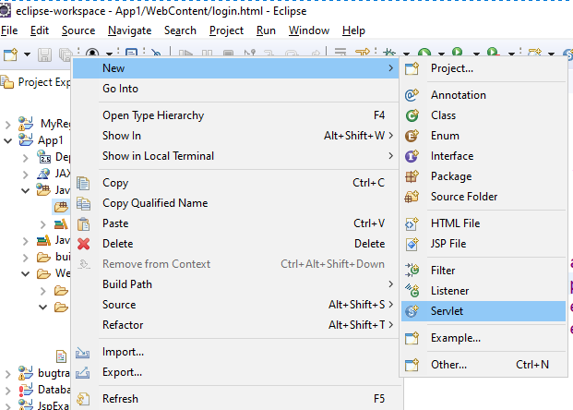
Step 5- Create servlet for login page

Slide 30
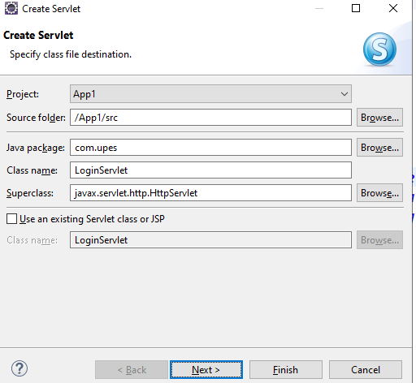

Slide 31
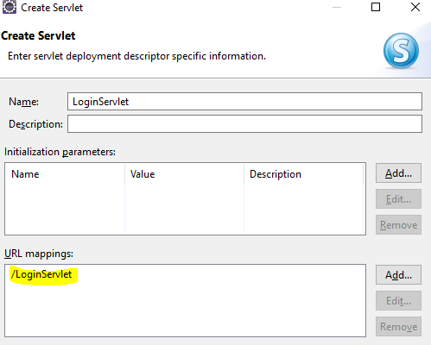
This url name is required for providing the mapping between login.html file
and the corresponding servlet

Slide 32
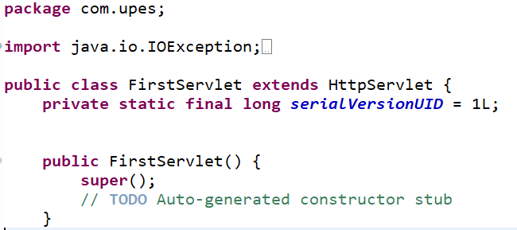
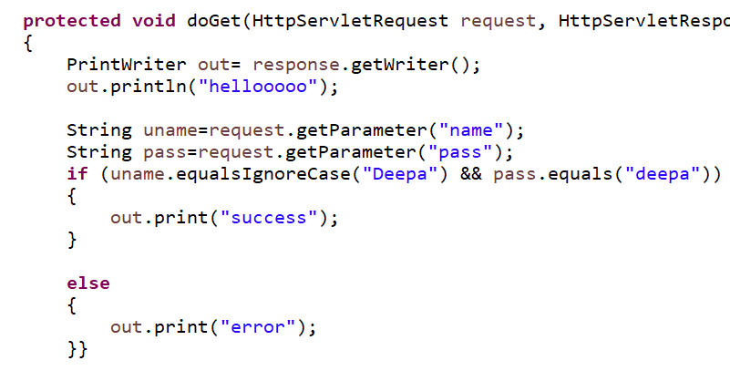
An Example of login Servlet >> FirstServlet.java

Slide 33
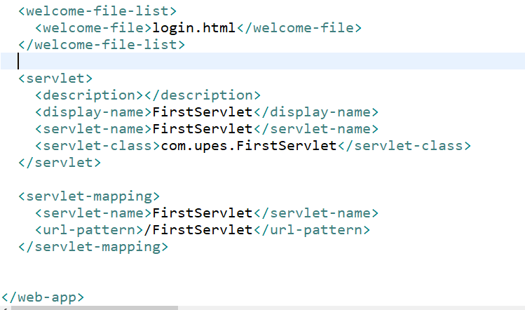
Step 6 - Modify Web.xml file
Verify the url pattern

Slide 34
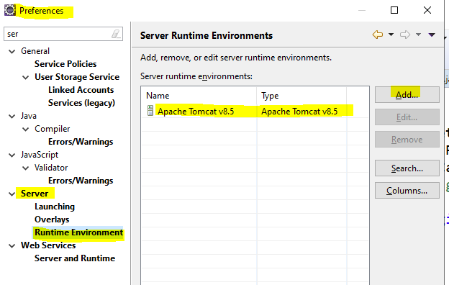
Step 7- Configure the server before running the application

Slide 35
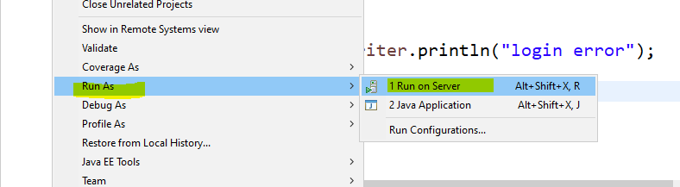
Step 8- Run the application: Right click on the application and run on the server

Slide 36
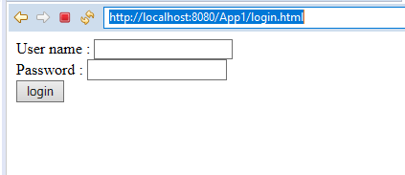
Notes:
https://www.youtube.com/watch?v=EkacxN8gx08
https://www.youtube.com/watch?v=7bl8UrkYbaU

Slide 37
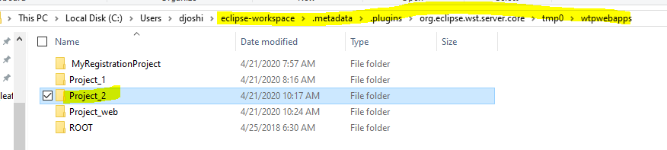
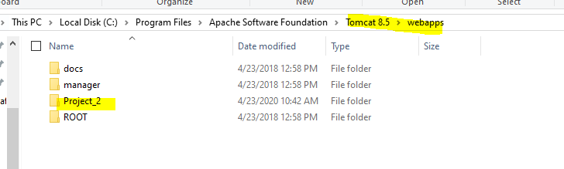
Run the web application manually (not from eclipse)
Deploy the project in webapps folder inside tomcat server: copy your project folder and place it inside webapps folder of tomcat server
copied

Slide 38
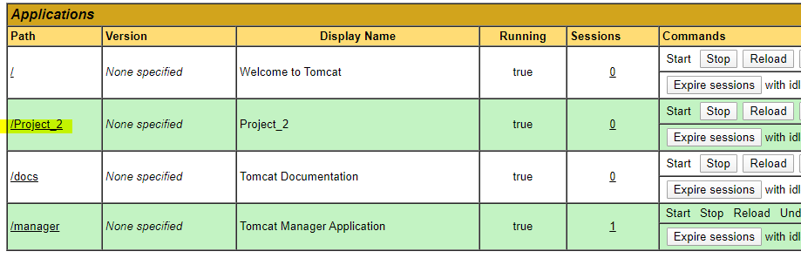
Start the server from Apache tomcat folder
Goto : http://localhost:8080/
Go to Managerapp and check all the deployed applications

Slide 39
Web application logics
Presentation logics: We develop html file using presentation logic using html, css, etc. presentation logic is displayed at client side.
Requested data gathering logics: Logics used to retrieve client data (request.getParameters()) using servlets, jsp, structs spring etc.
Validation logics: Validate the retrieved data jsp, javascript
Business logics: Process the data (main logic of the application), servlets, jsp, structs spring etc.
Persistence logic (Hibernate framework): Logics that interact with the database, (JDBC , Hibernate framework)
JDBC is used to write the persistence logic
Note: Hibernate code is internally converted into JDBC (performance is slow)
Session management logic: Session (period of the time), (open bank site and if we do not perform any activity the session time gets out) servlets, jsp
Middleware services: optional services to application.

Slide 40
JDBC - Imp
Java Application
JDBC driver
Database
Driver Manager pool to maintain all the drivers
Register drivers into Driver
manager service
Retrieve the driver

Slide 41
Driver provides connection between java to database
DR
I
V
E
R
Java syntax
String a= “Ram”
Database can understand sql query
Java API
SQL API

Slide 42
Types of Driver (Imp)
Types of driver:
Type-1>>JDBC-ODBC bridge driver- Introduced by SUN microsystem with interdependency on Microsoft corporation.
JDBC calls
ODBC calls
Database calls
JDBC-ODBC bridge driver
DSN-selecting database
(oracle, access etc.)

Slide 43
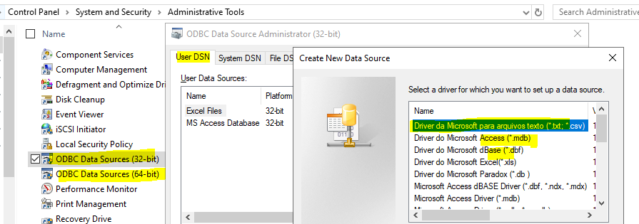
It depends on ODBC calls
Two conversions are required, performance degraded
Without DSN, driver is unable to work (distributed project into 10 machines, every machine is required to set the DSN name
Not recommended for web app but recommended for standalone application.

Slide 44
Type-1 driver
Type-1 driver or JDBC-ODBC bridge driver uses ODBC driver to connect to the database. The JDBC-ODBC bridge driver converts JDBC method calls into the ODBC function calls. Type-1 driver is also called Universal driver because it can be used to connect to any of the databases.
As a common driver is used in order to interact with different databases, the data transferred through this driver is not so secured.
The ODBC bridge driver is needed to be installed in individual client machines.
Type-1 driver isn’t written in java, that’s why it isn’t a portable driver.
This driver software is built-in with JDK so no need to install separately.
It is a database independent driver.
Type-2 driver
The Native API driver uses the client -side libraries of the database. This driver converts JDBC method calls into native calls of the database API. In order to interact with different database, this driver needs their local API, that’s why data transfer is much more secure as compared to type-1 driver.
Driver needs to be installed separately in individual client machines
The Vendor client library needs to be installed on client machine.
Type-2 driver isn’t written in java, that’s why it isn’t a portable driver
It is a database dependent driver.

Slide 45
Type 2: Native driver (Partial java driver)
JDBC calls are converted into corresponding database calls.
Type 3: Middleware or network protocol driver
The Network Protocol driver uses middleware (application server) that converts JDBC calls directly or indirectly into the vendor-specific database protocol. Here all the database connectivity drivers are present in a single server, hence no need of individual client-side installation.
Type-3 drivers are fully written in Java, hence they are portable drivers
JDBC calls
DB calls
Native driver
Notes:
We identify the driver uniqely as Every driver has its own url pattern and class nam

Slide 46
No client side library is required because of application server that can perform many tasks like auditing, load balancing, logging etc.
Network support is required on client machine.
Maintenance of Network Protocol driver becomes costly because it requires database-specific coding to be done in the middle tier.
Switch facility to switch over from one database to another database.
JDBC calls
DB calls
Middleware services
Notes:
Which Driver to use When?
If you are accessing one type of database, such as Oracle, Sybase, or IBM, the preferred driver type is type-4.
If your Java application is accessing multiple types of databases at the same time, type 3 is the preferred driver.
Type 2 drivers are useful in situations, where a type 3 or type 4 driver is not available yet for your database.
The type 1 driver is not considered a deployment-level driver, and is typically used for development and testing purposes only.

Slide 47
Type-4 driver
Type-4 driver is also called native protocol driver. This driver interact directly with database. It does not require any native database library, that is why it is also known as Thin Driver.
Does not require any native library and Middleware server, so no client-side or server-side installation.
It is fully written in Java language, hence they are portable drivers.
Database specific (configure the jar file for using the database)
JDBC calls
DB calls
Thin driver

Slide 48
Note
JDBC applications are executed by JVM
Servlets/ JSP applications are executed by Server
Who execute the query ? DBE (Database Engine)
Key interface of JDBC
1. Connection interface: to provide connection between java application and database
2. Statement object: send query to database side (execution of query) DBE executes the query
3. PreparedStatement Object: child interface of statement interface. Used to execute the query,
Internal database management executes 4 queries. Reduces the number of steps, performance is increased
4. Callable statement: child interface of PreparedStatement
Oracle contains Procedure and functions, to execute them we use callable statement
5. ResultSet: store the data coming from the database (a=select * from emp)
6. ResultSetMetadata: stores data about the data
7. Database Metadata: complete info about the database which we connect to.
8. SavePoint: Perform transaction operations (rollback upto the third transaction instead the first )

Slide 49
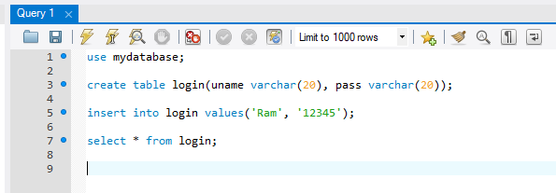

1. Open MySql workbench

Slide 50
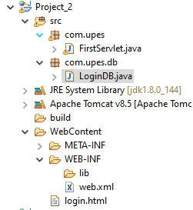
2. Create a separate class for database related queries

Slide 51
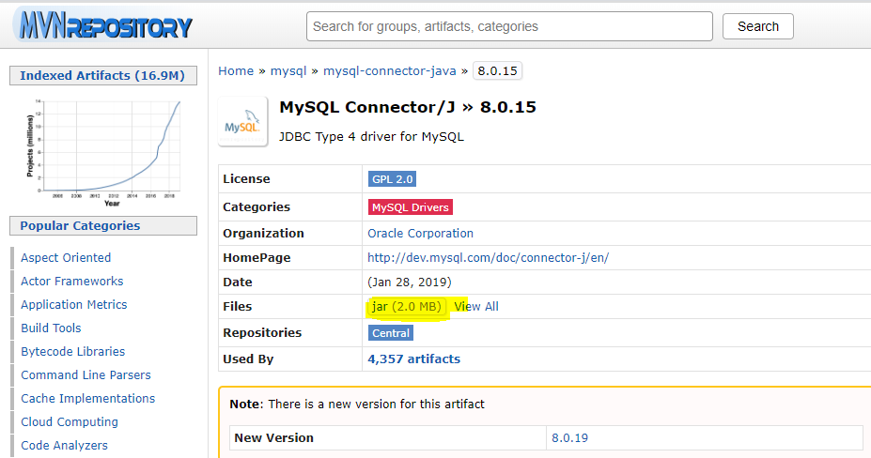
3. Downlaod MySql connector.jar file
JDBC Type 4 driver for MySQL

Slide 52
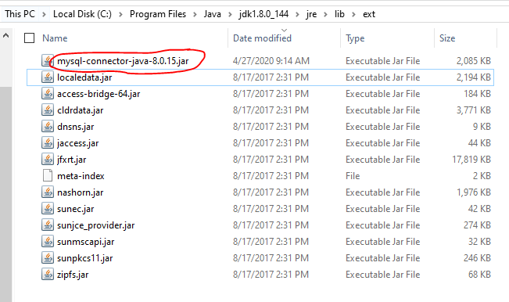
4. Add this jar file to the below path
The project is also uploaded with the name (database.rar file). Extract it and you can understand it.

Slide 53
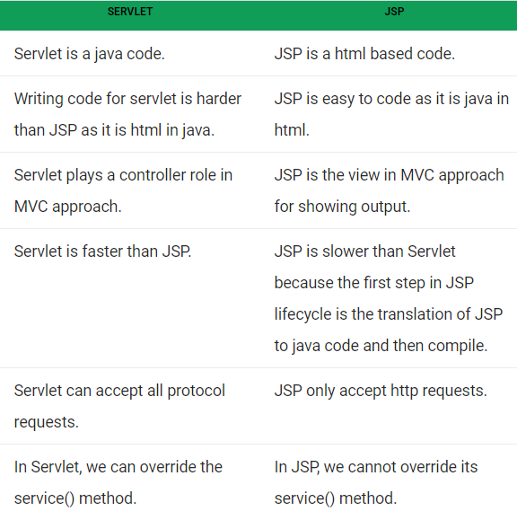
JSP vs Servlet (Imp)

Slide 54
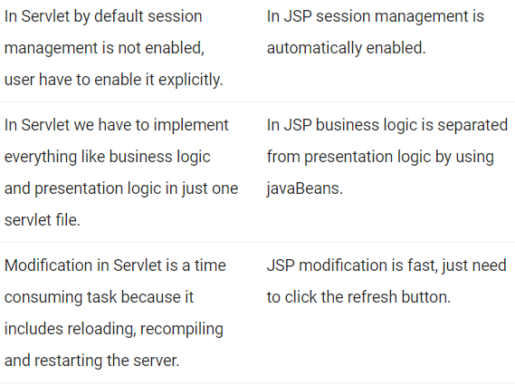

Slide 55
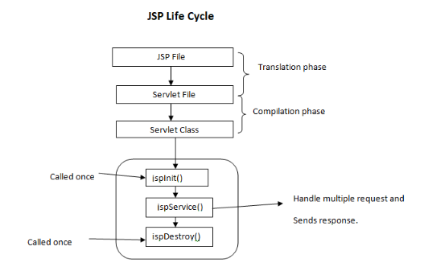
JSP lifecycle(Imp)

Slide 56
Study from here:::
https://www.guru99.com/jsp-life-cycle.html
Why JSP?
Make dynamic web pages
Executes on server side and output is displayed on client side
We require JSP container to execute a jsp provided by web server.
Example: System date can be displayed using jsp and javascript. However client date displayed using javascript and server date is displayed using jsp since javascript executes on browser side.

Slide 57
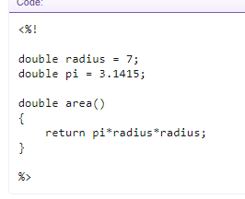
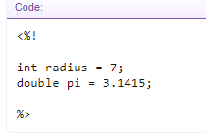
Imp JSP tags
Declarations JSP declarations starts with '<%!' and ends with '%>'. In this you can make declarions such as int i = 1, double pi = 3.1415 etc. If needed, you can also write Java code inside declarations.

Slide 58
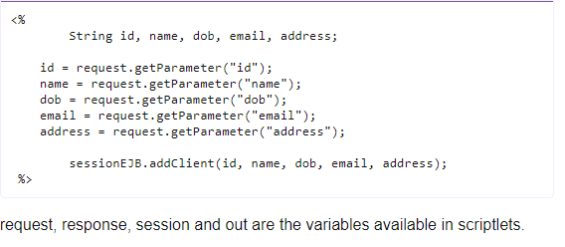
2. Scriptlets
JSP Scriptlets starts with '<%' and ends with '%>'. This is where the important Java code for JSP page is written.

Slide 59
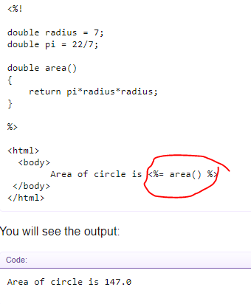
3. Expressions
JSP expressions starts with '<%=' and ends with '%>'. If you want to show some value, you need to put it in between these tags.

Slide 60
Refer “JSPExample.rar” file for the example
Note: All the files are uploaded on github (djoshi712)

